Slide 1
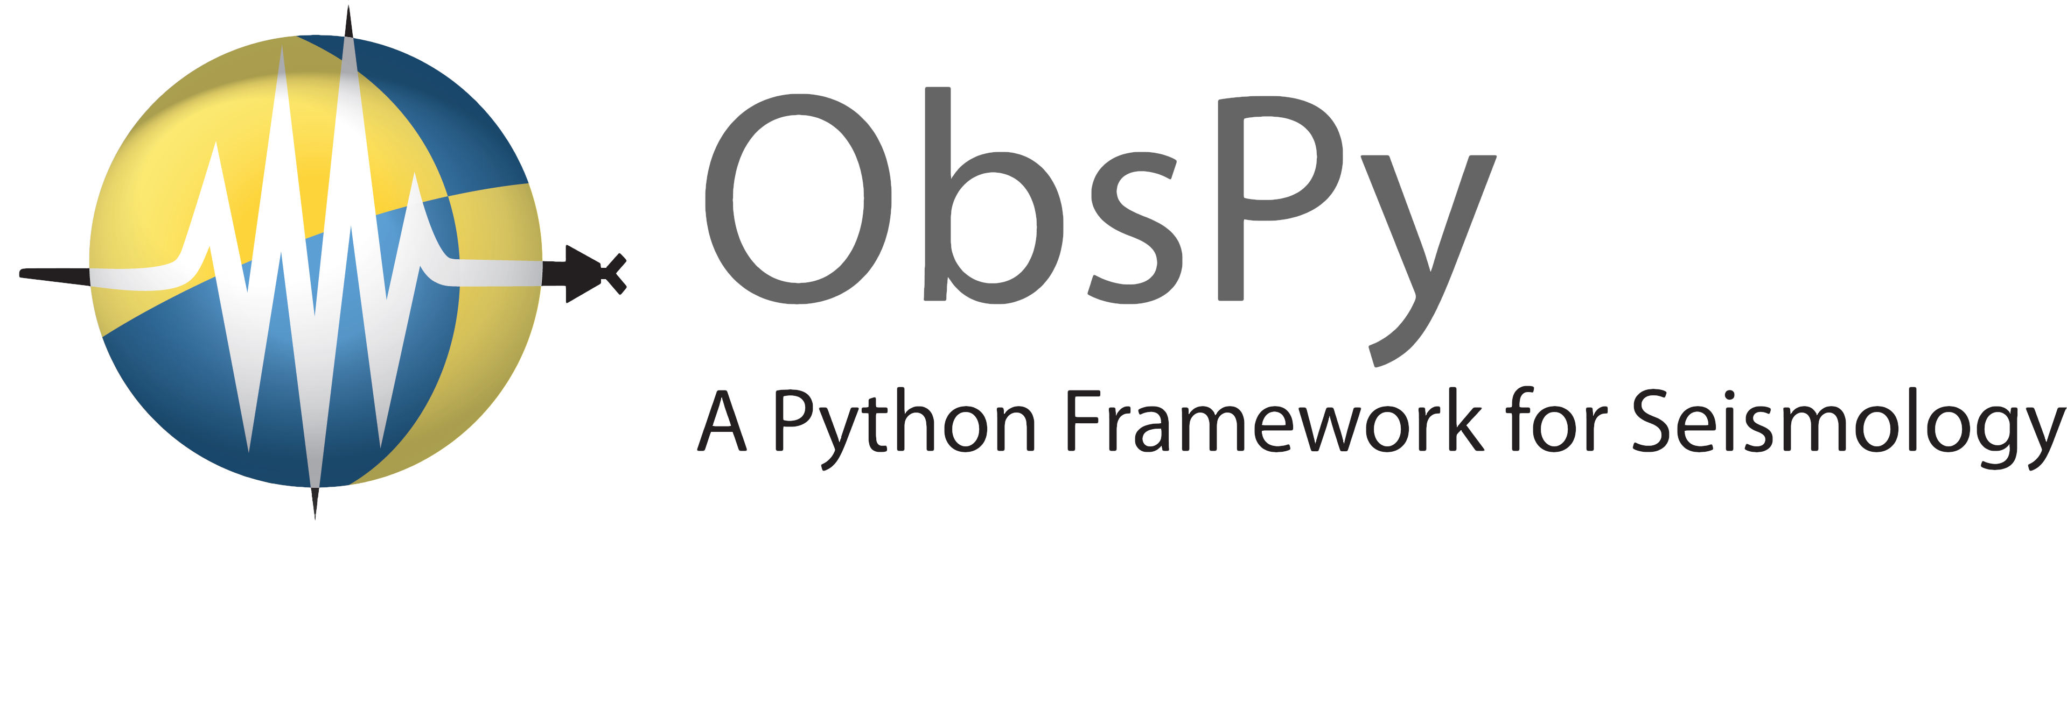


Seznamme se: ObsPy
Luděk Vecsey
GFÚ Praha, kafeseminář, 31.10.2018

Slide 2

Introduction to Python
Python is a high-level programming language
Free, open sourced and community driven
“Batteries Included”
  a standard distribution includes many modules
Dynamic typed, scalable, object oriented and functional
Invented in the Netherlands, early 90s by Guido van Rossum
Named after Monty Python
Increasingly popular

Slide 3
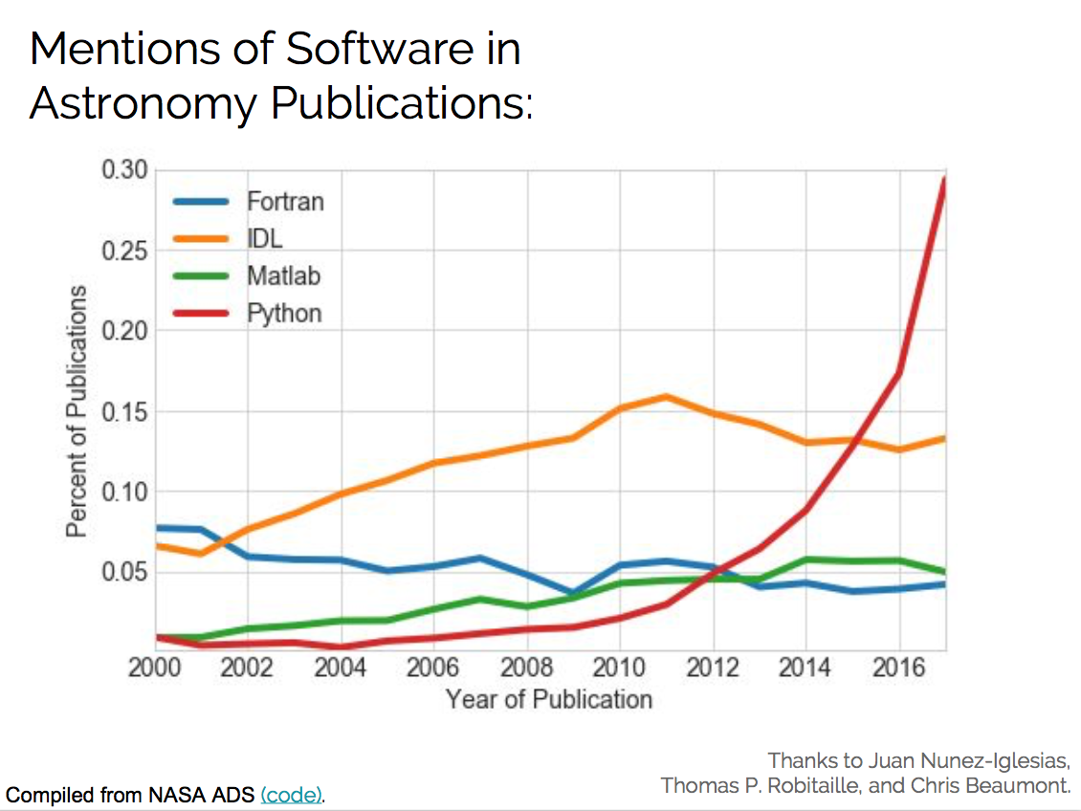

Slide 4
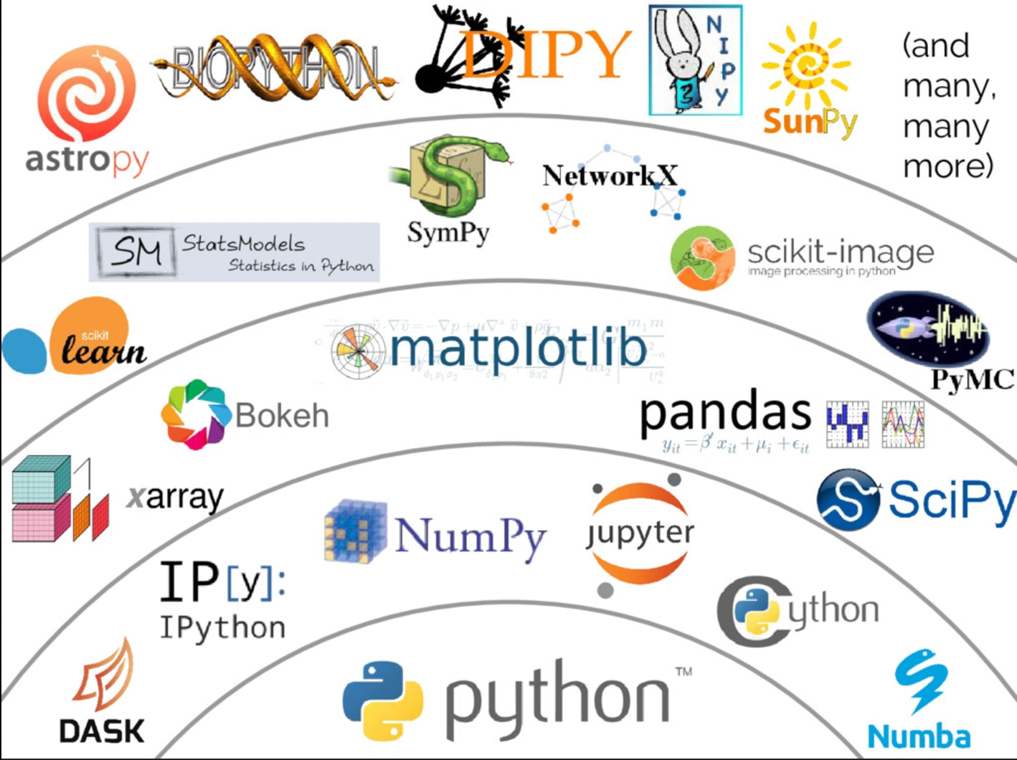

Slide 5
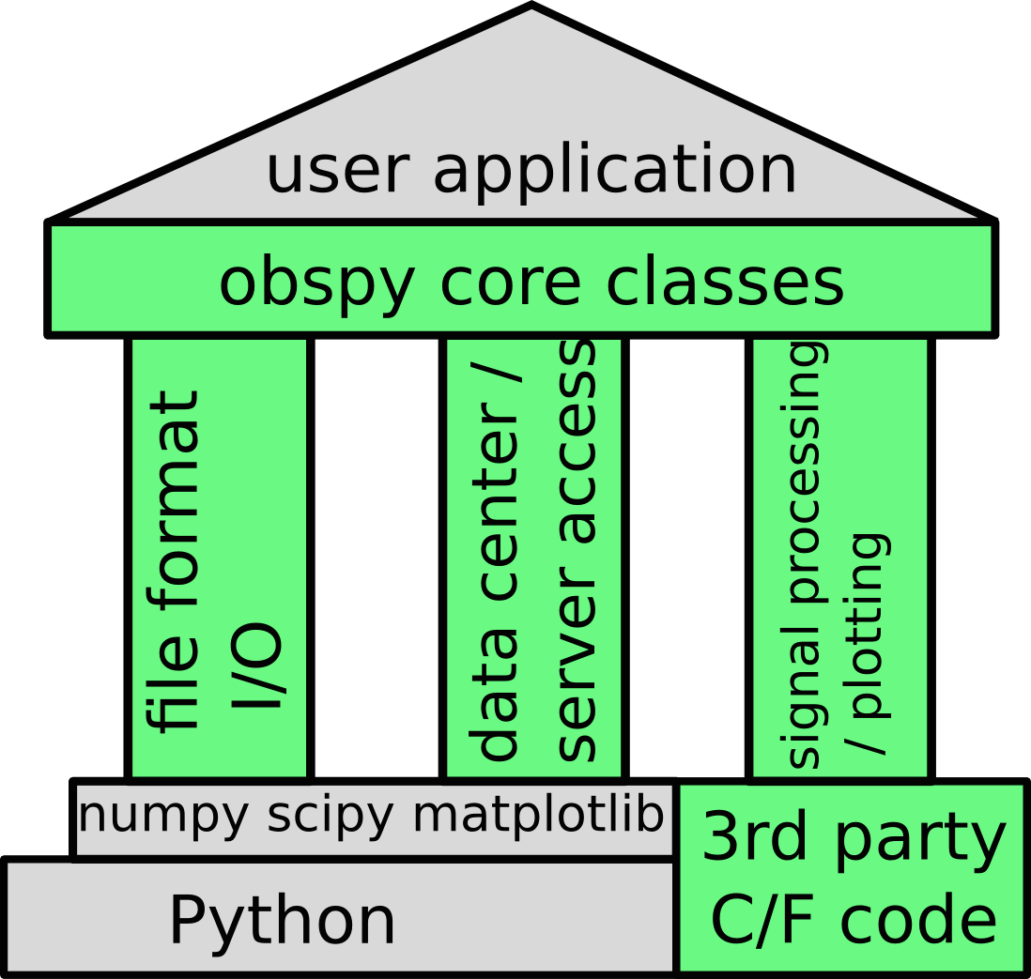
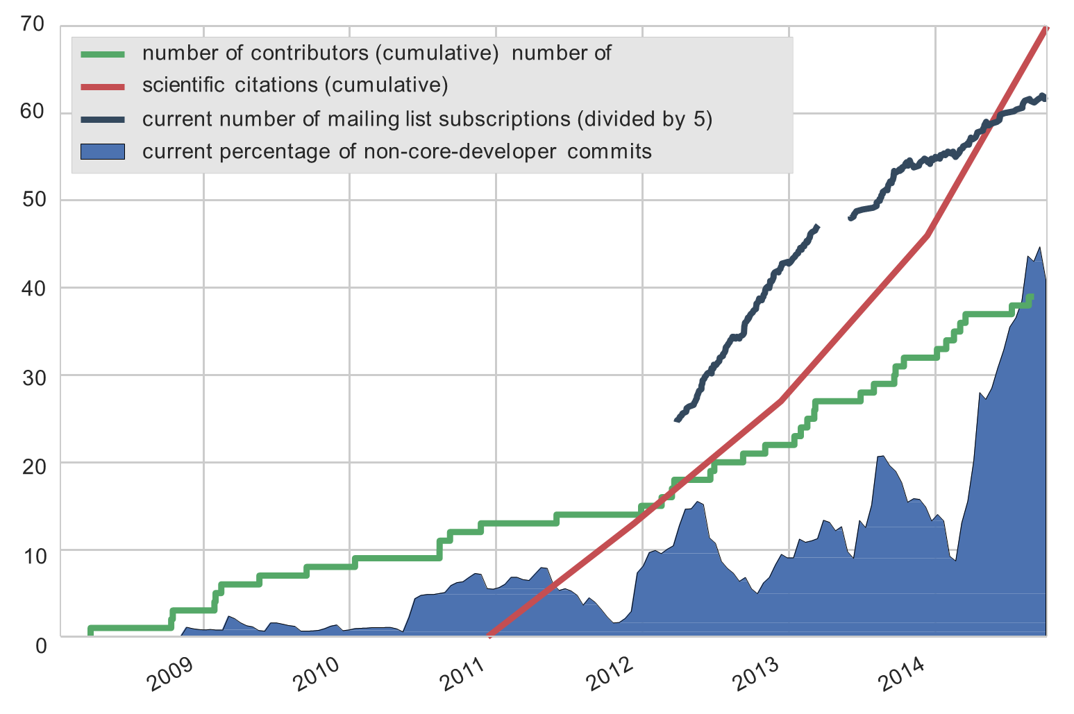
„A bridge for seismologists into the scientific Python ecosystem"
Contributors:
Lion Krischer
Tobias Megies
Robert Barsch
Moritz Beyreuther
Elliott Sales de Andrade
and a lot of others
http://www.obspy.org
https://docs.obspy.org/tutorial

